Slide 1


LANGUAGE TRANSLATOR WITH USING PYTHON.
HARSHITHA. G(192211603)
NITHIGNYA. C(192211603)
AKHILA. M(192210549)
DEPARTMENT OF COMPUTER SCIENCE AND TECHNOLOGY
PYTHON PROGRAMMING FOR WEB APPLICATIONS
CODE : CSAO880
FACULTY : YUVARANI

Slide 2
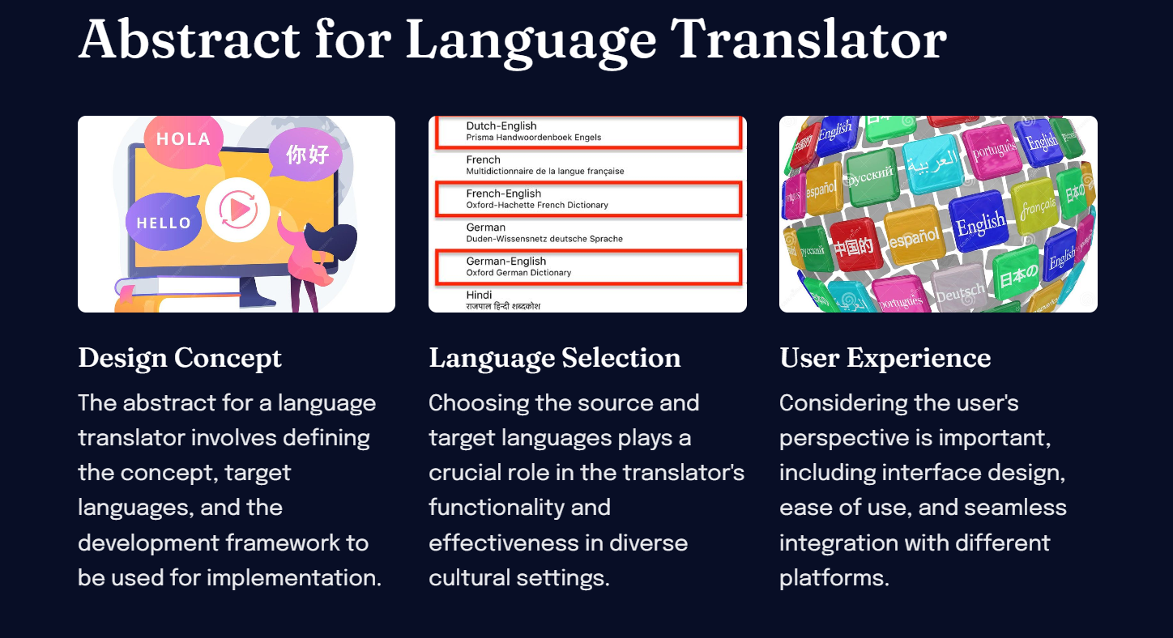

Slide 3
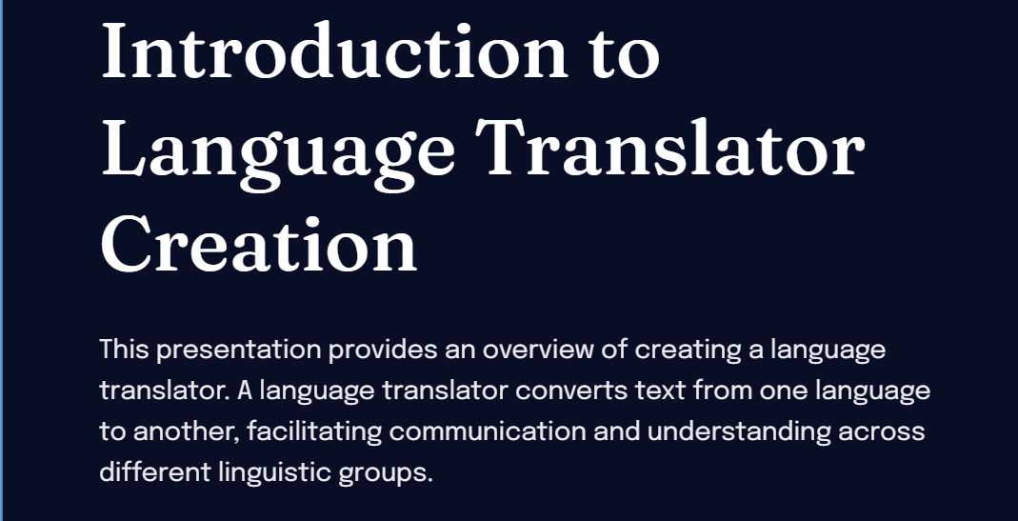
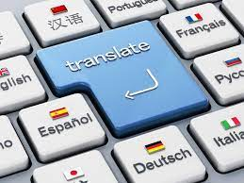

Slide 4
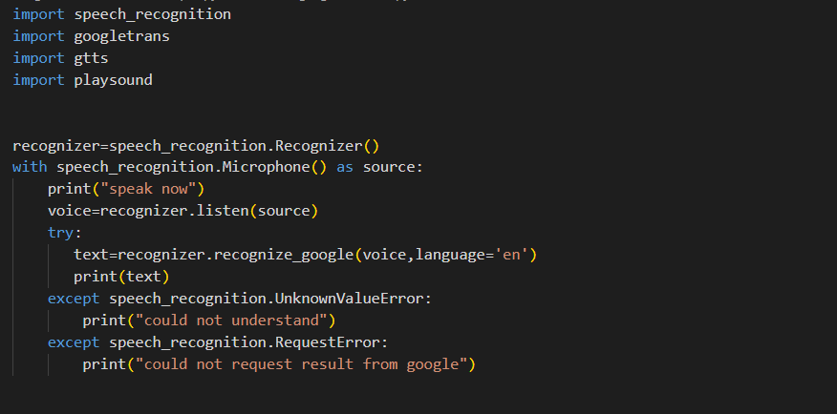
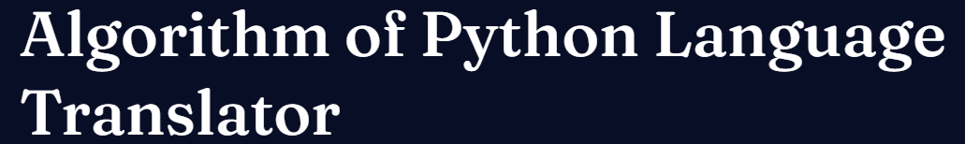
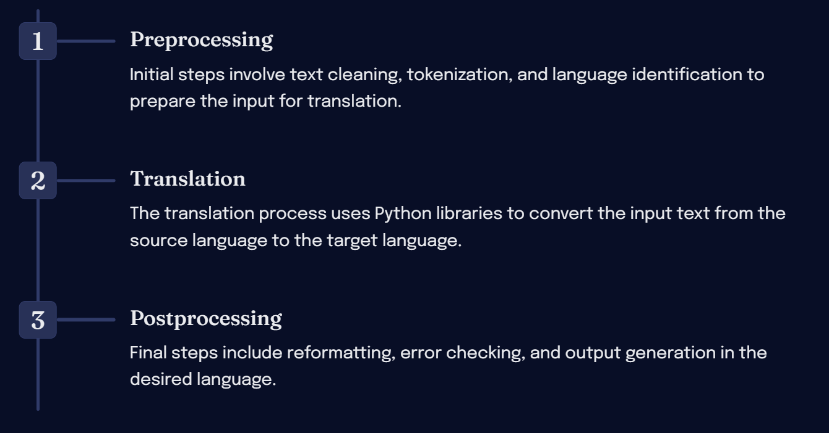

Slide 5

Modules used:
SPEECH RECOGNITION:
The process of enabling a computer to identify and respond to the sounds produced in human speech.
GOOGLE TRANS: multilingual neural machine translation service developed by Google to translate text, documents and websites from one language into another.
PLAYSOUND:The play sound module is a cross platform module that can play audio files. “pure Python, cross platform, single function module with no dependencies for playing sounds.

Slide 6

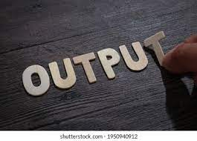
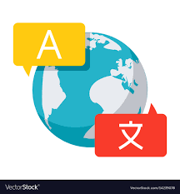
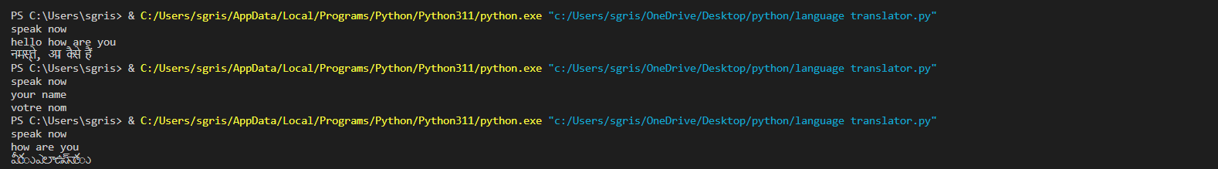

Slide 7
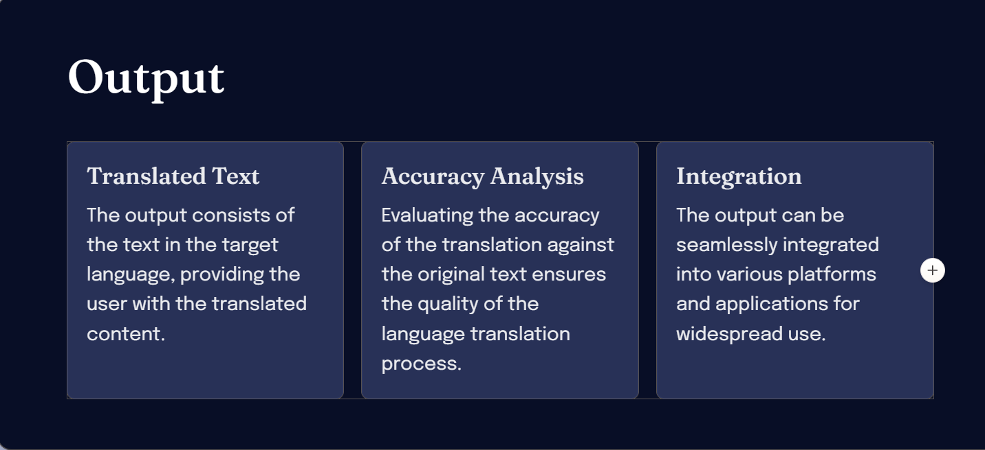
RESULT

Slide 8
